Slide 1
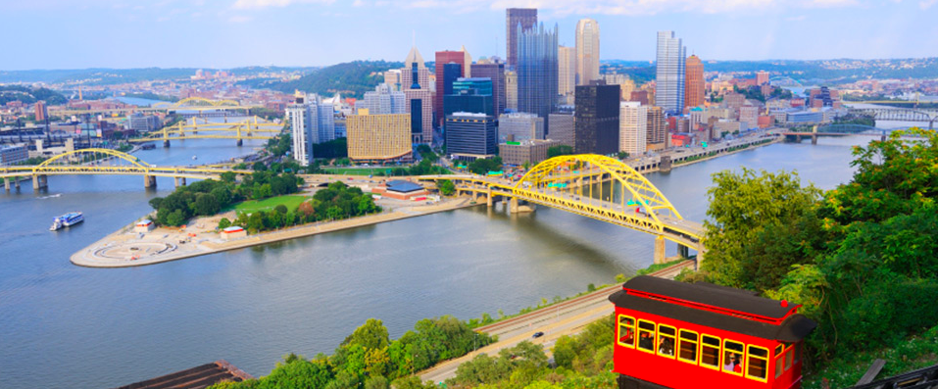
PRSA Pittsburgh
2022-2023 Renaissance Awards Sponsorship Opportunities

Slide 2
About PRSA Pittsburgh
PRSA Pittsburgh is one of the largest chapters within the East Central District, one of 10 PRSA districts. The East Central District represents members in 16 PRSA chapters concentrated in Indiana, Kentucky, Michigan, Ohio, Western and Northwestern Pennsylvania and West Virginia.
The PRSA Pittsburgh Mission
To create, educate, and empower a diverse community of communications professionals who value the role that public relations plays in their careers, their organizations, and the region.
Our Value Proposition
PRSA Pittsburgh believes public relations serves an increasingly vital role in the leadership, business, marketing, and communications functions of all organizations, and we aim to provide our members with the tools, support, education, and networking to play this role in their respective organizations.
We do this through:
Encouraging research, analysis, and discussion of the challenges and opportunities facing PR professionals today.
Strengthening and maintaining the highest standards of service and ethical conduct by all members of the profession.
Supporting the creation of mutually beneficial relationships between our members where diverse ideas, strategies and tactics can be shared.
Recognizing, rewarding, and sharing our members’ accomplishments.

Slide 3
PRSA Pittsburgh Renaissance Awards
Each year, PRSA Pittsburgh recognizes outstanding public relations practitioners, campaigns, and tactics throughout southwestern PA with the prestigious Renaissance Awards. The annual event regularly attracts more than 100 of the area’s most accomplished PR, communications, and marketing professionals.
Sponsoring this event puts your brand in front of a very captive audience on one of the biggest nights of the year for PR & Marketers in the Pittsburgh region. Renaissance sponsorships allow organizations to build on the prestige of this annual awards program to get their products, services, and people in front of the best and brightest members of the Pittsburgh PR community, including past and present PRSA PGH officers, lifetime Renaissance Hall of Fame inductees, agency leaders, chief marketing and communications officers, and some of the most talented PR graduates in the region.

Slide 4
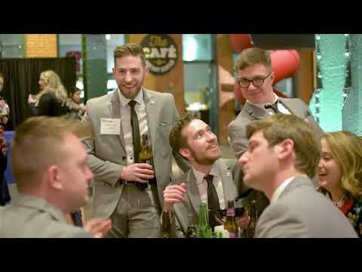
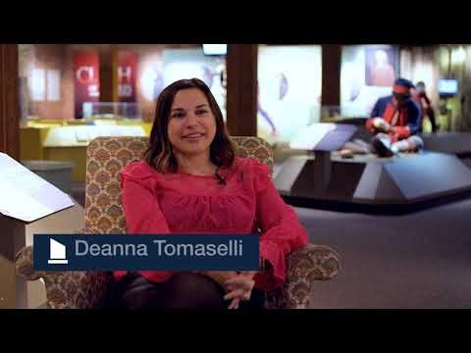
What are the Renaissance Awards?
Click to Play
PRSA Pittsburgh Renaissance Awards - 2018
PRSA Pittsburgh Renaissance Awards - 2019

Slide 5
Renaissance Awards – Presenting Sponsor
PRESENTING SPONSOR (Only one available)
Exclusive presenting rights in all event announcements, signage and emails – “PRSA Renaissance Awards presented by…”
Company name and logo prominently displayed on all signage during event
Opportunity to make introductory remarks to audience or present award of choice
VIP Seating (front row) for your company (up to 10 total seats)
Opportunity to distribute gift bags including branded promotional materials to all attendees
(5) Tickets to event
Full-page program ad in Renaissance Awards program
Four social media posts on PRSA Pittsburgh Social Media channels
(1) Blog post on prsa-pgh.org dedicated to your organization
PACKAGE COST: $4,000

Slide 6
Renaissance Awards – Networking Sponsor
NETWORKING SPONSOR (Only one available)
Exclusive drink sponsorship rights in all event announcements, signage and emails – “PRSA Renaissance Awards Networking Happy Hour presented by…”
Opportunity to name the official PRSA Renaissance drink
Logo recognition on all happy hour high-top tables
(3) Tickets to event
Half-page program ad in Renaissance Awards program
Two social media posts on PRSA Pittsburgh Social Media channels
PACKAGE COST: $2,000

Slide 7
Renaissance Awards – Champions Sponsor
CHAMPIONS SPONSOR (Only one available)
Exclusive presenting rights in all event announcements, signage and emails – “Our PRSA Renaissance Awards champions toast sponsored by…” (held after the awards ceremony)
Sponsor watermark on official PRSA Champions photo that is sent to all attendees and shared on PRSA Pittsburgh social channels
Company name and logo prominently displayed on all signage during event
(3) Tickets to event
Half-page program ad in Renaissance Awards program
Two social media posts on PRSA Pittsburgh Social Media channels
PACKAGE COST: $2,000

Slide 8
Renaissance Awards – After Party Sponsor
AFTER PARTY SPONSOR (Only one available)
Exclusive drink sponsorship rights in all event announcements, signage and emails – “PRSA Renaissance Awards After Party presented by…”
Opportunity to name the official PRSA Renaissance drink at Bar Louie
Logo recognition at Bar Louie and handouts you’d like to provide
(2) Tickets to event
Half-page program ad in Renaissance Awards program
Two social media posts on PRSA Pittsburgh Social Media channels
PACKAGE COST: $1,000

Slide 9
Renaissance Awards – Award Sponsor
AWARD SPONSOR (Three available)
Recognition as the [AWARD OF YOUR CHOICE] sponsor at the PRSA Renaissance Awards Ceremony “PRSA Renaissance Awards [AWARD OF YOUR CHOICE] presented by…”
One minute of remarks to tee up [AWARD OF YOUR CHOICE] Award
Company name and logo included in all event announcements, signage and emails
Company name and logo prominently displayed on all signage during event
(2) Tickets to event
Two social media posts on PRSA Pittsburgh Social Media channels
PACKAGE COST: $1,000

Slide 10
Renaissance Awards – Supporting Sponsor
SUPPORTING SPONSOR
Company name and logo included in all event announcements, signage and emails
Company name and logo prominently displayed on all signage during event
(2) Tickets to event
Two social media posts on PRSA Pittsburgh Social Media channels
PACKAGE COST: $500

Slide 11
Renaissance Awards – Custom Packages
DON’T SEE THE PACKAGE YOU’RE LOOKING FOR?
No worries! If you have other sponsorship ideas or needs and would like to discuss creating a custom Renaissance Awards sponsorship, please contact Jeff Krakoff, Sponsorship Chair. jeffk@krakoffcomm.com

